Slide 1

MID TERM DEFENSE
One Stop for trekking solution
BCA 4 th Semester
Laxmi Thami (6-2-263-16-2021)
Siddhartha Shakya(6-2-263-29-2021)
Kamal Tamrakar
HOD/CO-ORDINATOR

Slide 2

INTRODUCTION
DFD 0,1
USE CASE DIAGRAM
ACTIVITY DIAGRAM
TABLE IN DATABASE SCHEMA
GANTT CHART
SCREEN LAYOUT

Slide 3
Introduction
Development of a unique e-commerce website targeting Nepal's trekking market.
Leveraging Nepal's trekking landscape and cultural heritage.
Offering a one-stop destination for adventurous travelers.
Providing curated selection of trekking gear, personalized recommendations, and local expertise.
Utilizing CRUD for achieving necessary functionality.

Slide 4
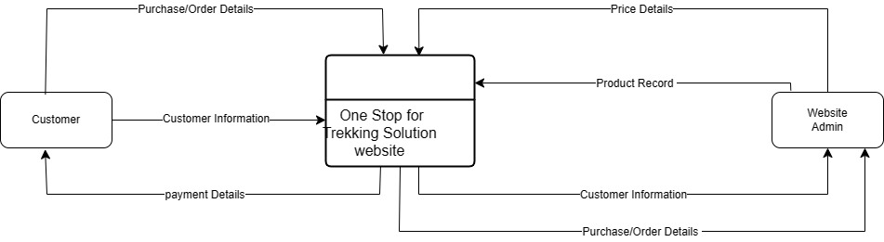
DFD LEVEL 0

Slide 5
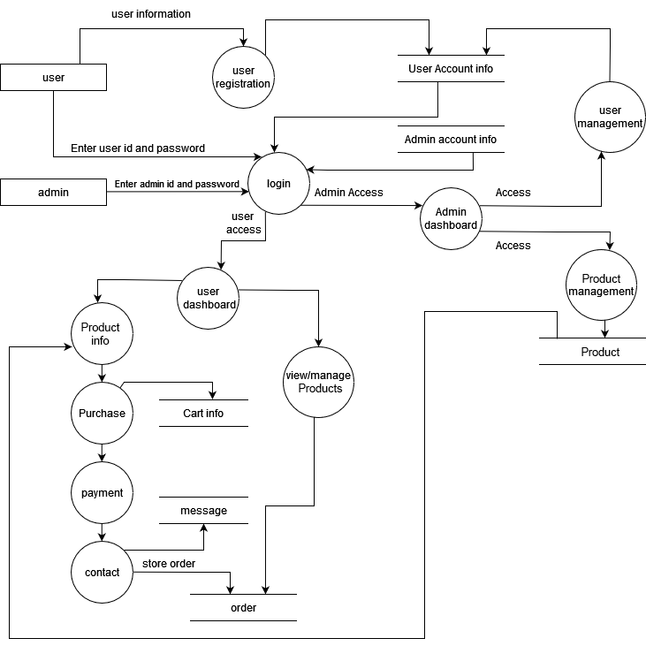
DFD LEVEL 1

Slide 6
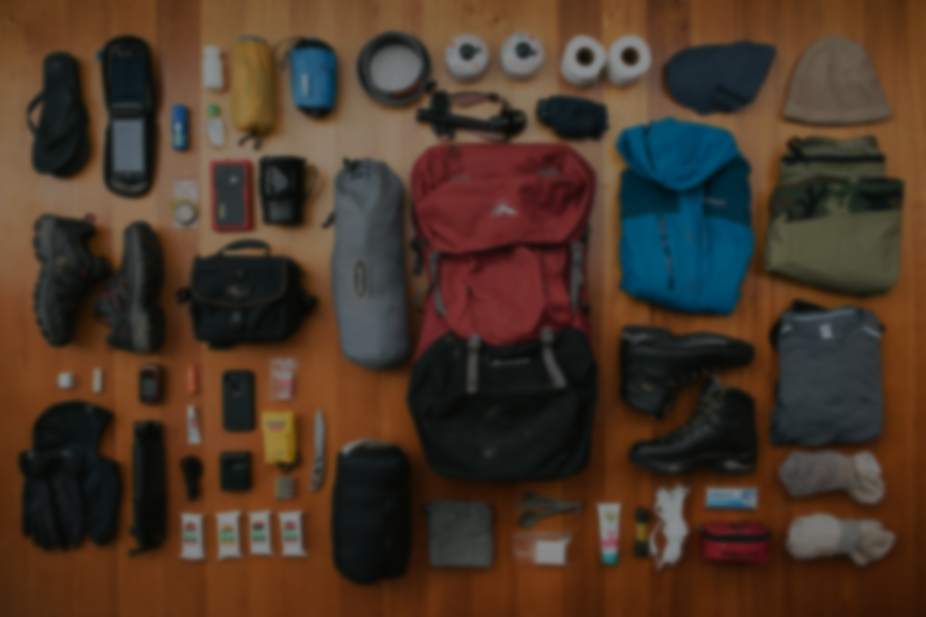
3.USE CASE DIAGRAM

Slide 7
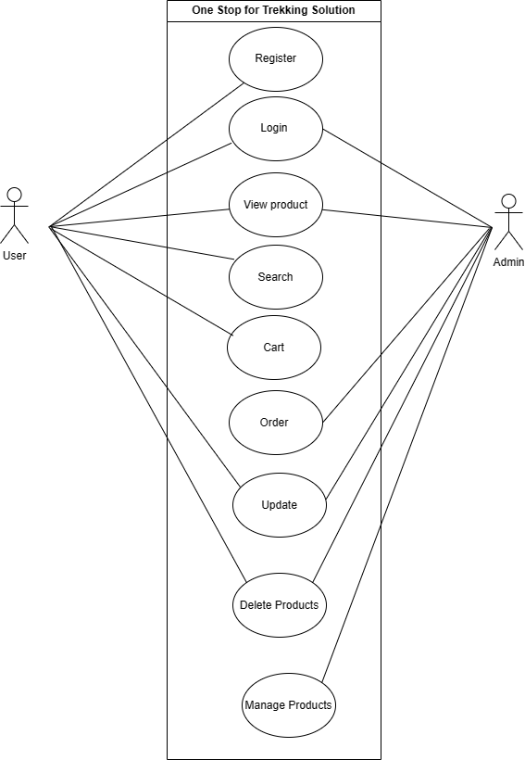
USE CASE DIAGRAM

Slide 8
4.ACTIVITY DIAGRAM

Slide 9
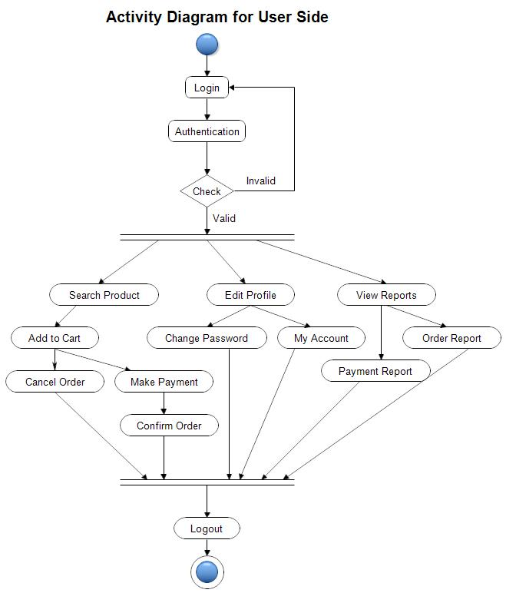

Slide 10
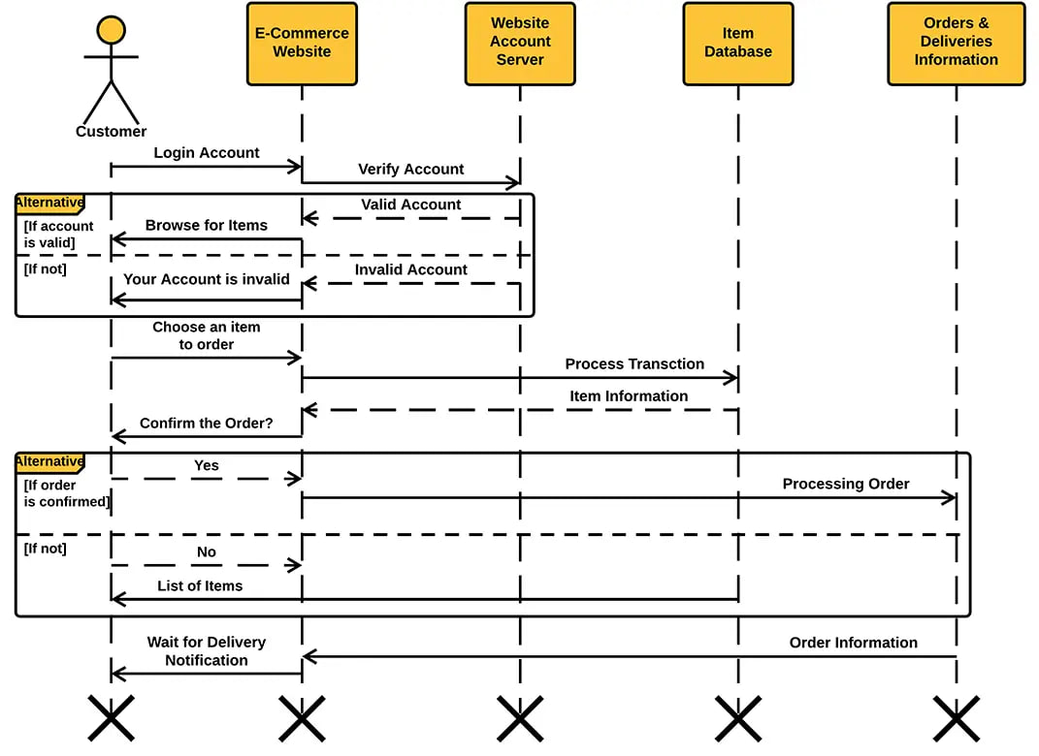

Slide 11
5.TABLE IN DATABASE SCHEMA

Slide 12
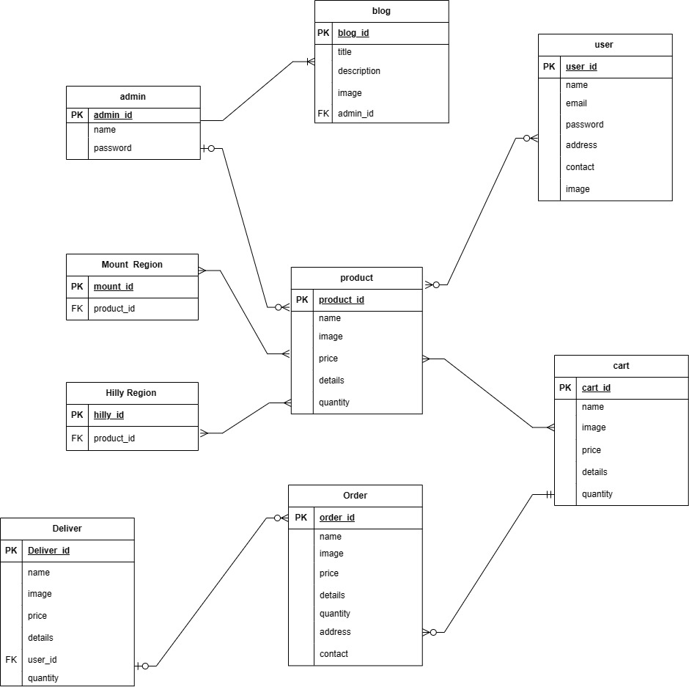
DATABASE SCHEMA

Slide 14
6. GANTT CHART

Slide 15
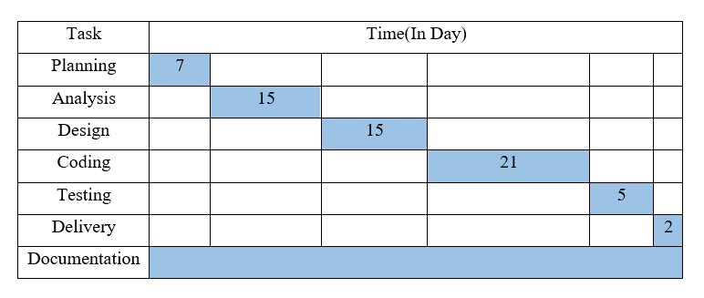
Gantt chart

Slide 16
7.SCREEN LAYOUT

Slide 18
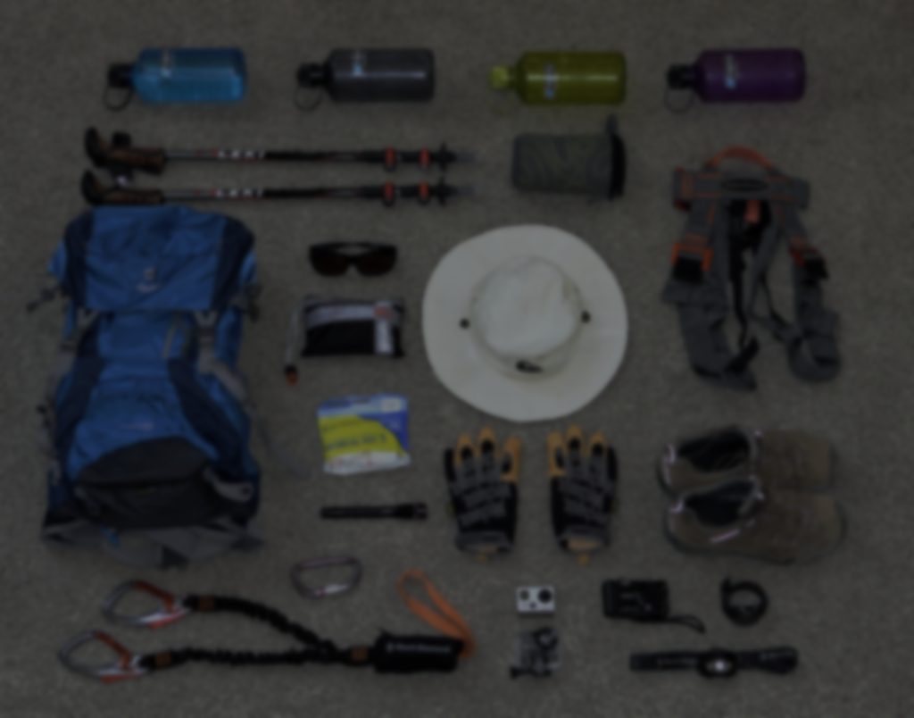
Expected Outcome
Cultural and Local Engagement
Community Involvement
Participation in Tourism Promotion

Slide 19
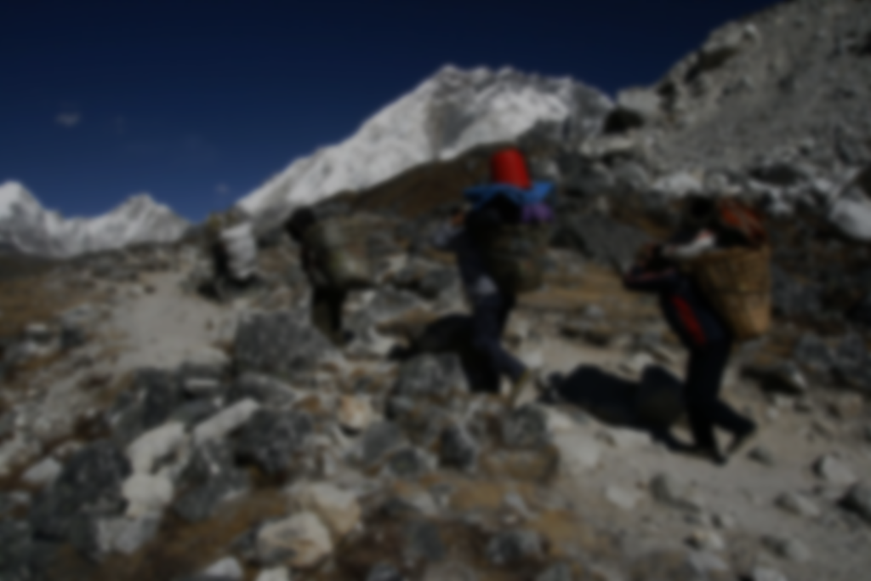
Limitation
Dependency on third-party suppliers and logistics may lead to delays.
Security vulnerabilities in online transactions.
Competition from established offline and online retailers.

Slide 20


Slide 21
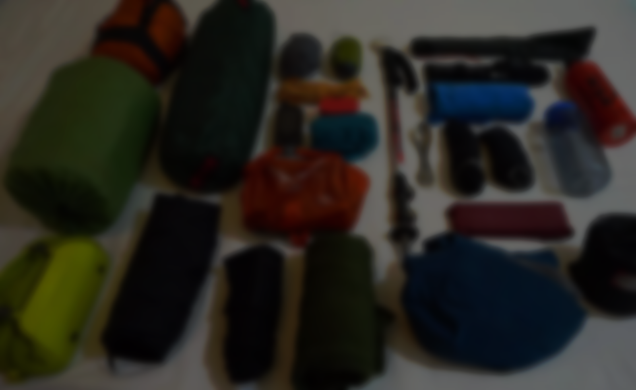
Thank You

